Slide 1
Data mining Project on IMDB Score/Rating
California State university- East Bay
Karthik Kodakandla
Shailaja Mysugari
Sharmila Velugula
Shashank Bharat
Soon Chye Lim
Movie Ratings **********/10

Slide 2
Goal
Who doesn’t like movies ☺
Can we Predict IMDB Score/Rating?
Factors effecting Gross income ?
Success

Slide 3
All about DATA
Variable name | Variable Description
color | Film colorization. ‘Black and White’ or ‘Color’
director_name | Movie Director Name
num_critic_for_reviews | Number of Critic reviews on IMDB
duration | Movie Length in minutes
director_facebook_likes | Number of Facebook page likes for Director
actor_3_facebook_likes | Number of Facebook page likes for Actor 3
actor_2_name | Name of the Second Actor
actor_1_facebook_likes | Number of Facebook page likes for Actor 1
gross | Gross Earnings of the movie in USA ( USD)
genres | Film categorization
actor_1_name | Name of the Lead Actor
movie_title | Name of the Movie
num_voted_users | Number of people who Voted for the Movie
cast_total_facebook_likes | Number of Facebook page likes for Cast and crew
actor_3_name | Name of the Third Actor
facenumber_in_poster | Number of the Actors who featured in the Movie Poster
plot_keywords | Keywords describing the movie plot
movie_imdb_link | IMDB link of the movie
num_user_for_reviews | Number of People who gave review in IMDB
language | Movie language
country | Country where movie released
content_rating | Content rating of the movie
budget | Budget of the Movie ( in USD)
title_year | year on which movie released
actor_2_facebook_likes | Number of Facebook page likes for Actor 2
imdb_score | IMDB rating of the movie on IMDB Page
aspect_ratio | Aspect ratio the move was made in
movie_facebook_likes | Number of Facebook page likes for Movie
Kaggle : https://www.kaggle.com/carolzhangdc/imdb-5000-movie-dataset
Number of records: 5043
Number of Variables: 28

Slide 4
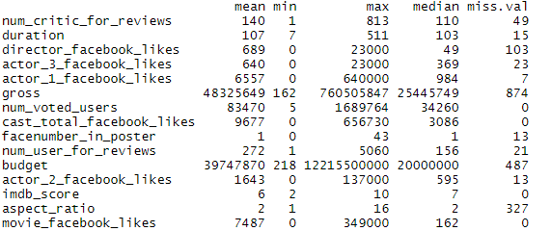
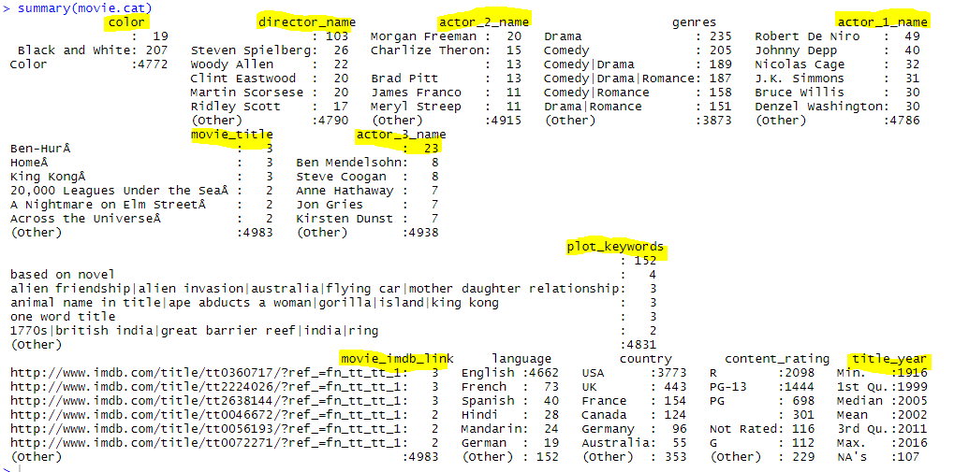
Data Cleaning
Load Data ⬅➔ movie.df<-read.csv("movie_metadata.csv",header=TRUE)
Handle Duplicates ⬅➔ sum(duplicated(movie.df))
Numerical Variables➔
Handle missing Values
Categorical variables =➔
Deleted columns which
are unique for each
Record.

Slide 5
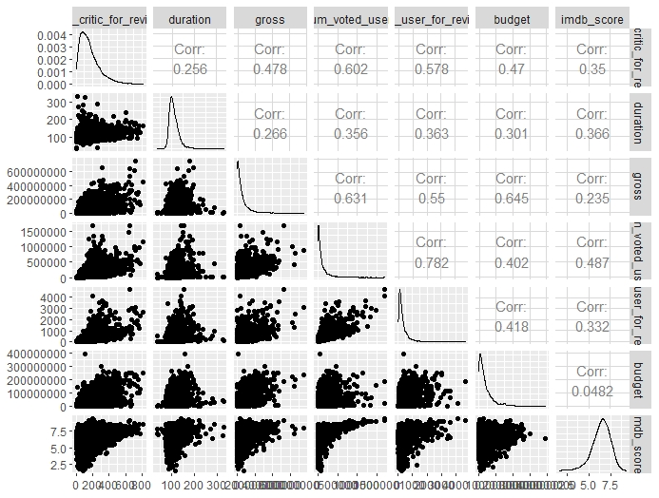
Data Cleaning
Outliers and correlation
Correction of column names
Outliers
gross
num_voted_users
Budget
num_critic_for_reviews

Slide 6
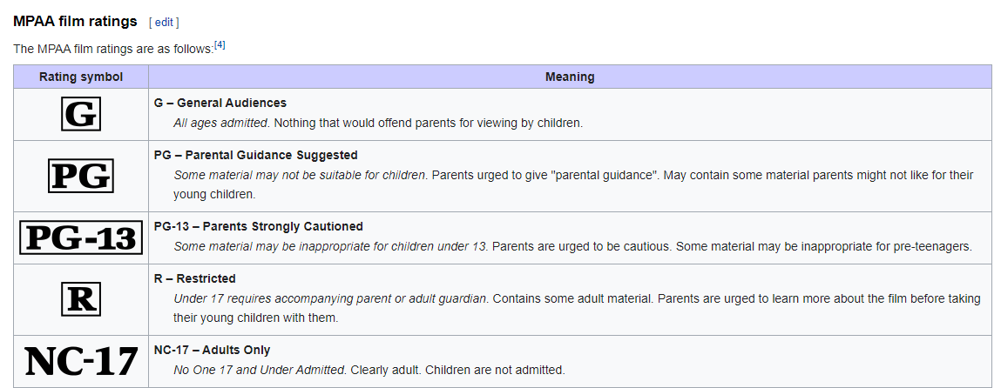
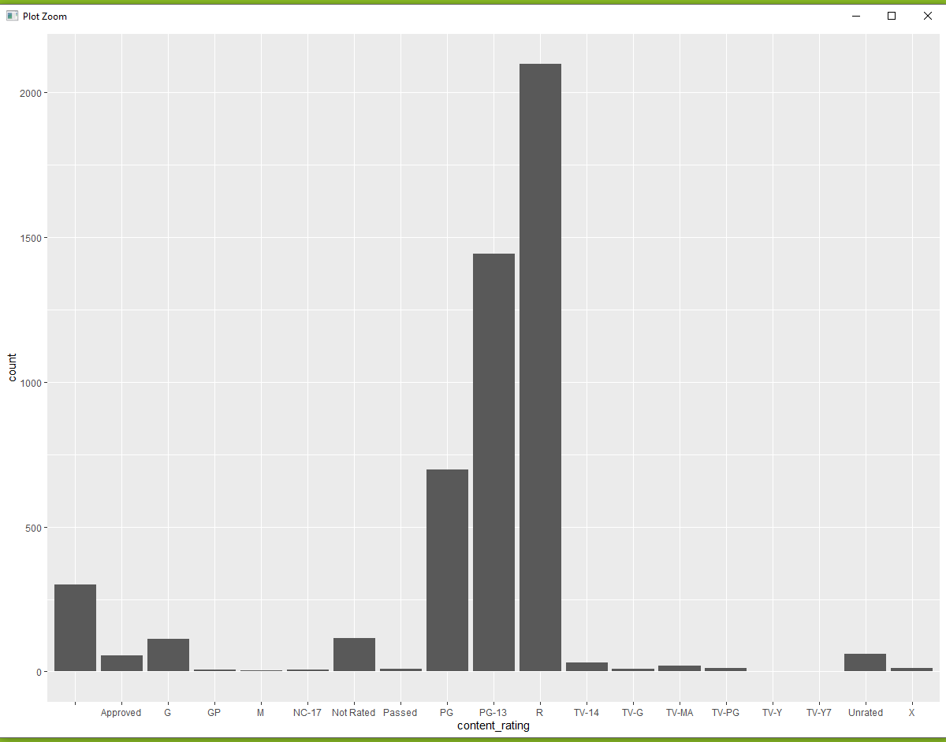
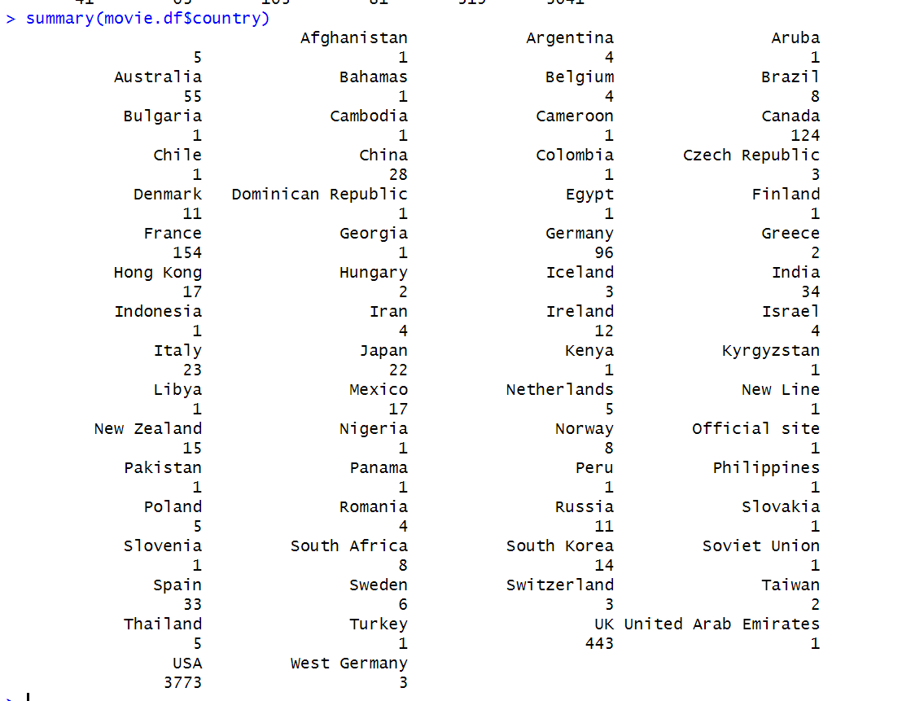
Data Preprocessing
Content rating grouping
Analysis of Variable Country
Levels in country is 66
Reduced the levels in the variable Country
Analysis of budget variable

Slide 7

Data Preprocessing
After all preprocessing the data available is
Data Partition
Train Data - 50 % of Total Data
Valid Data - 30% of Total Data
Test Data - 20% of Total Data

Slide 8
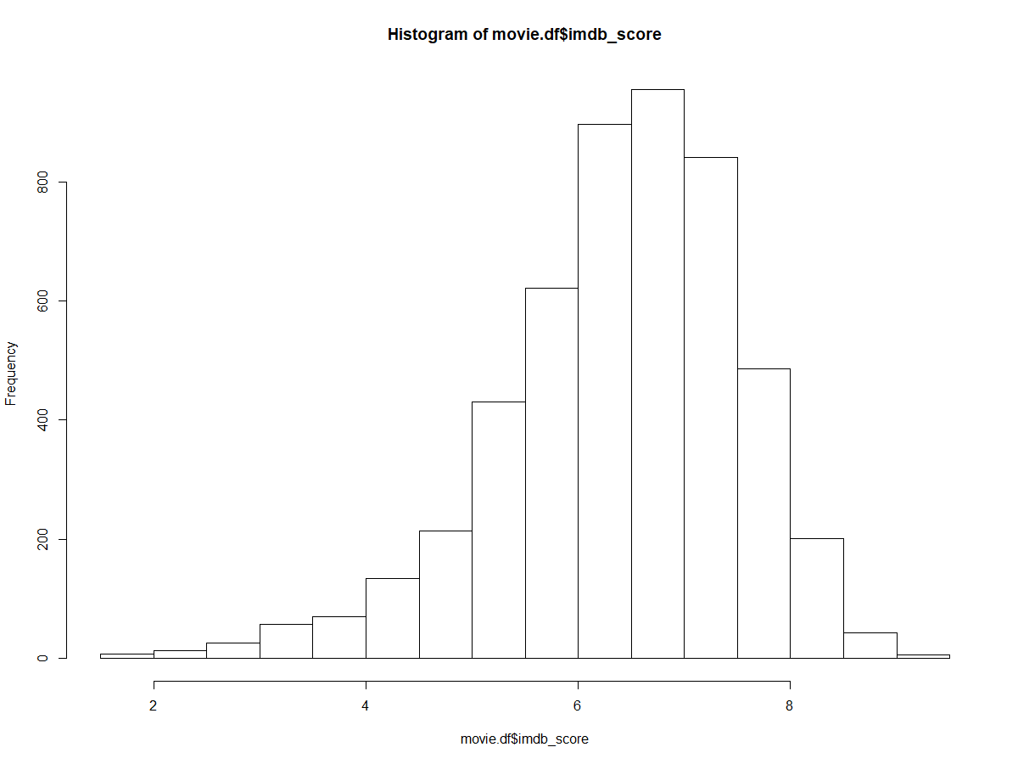
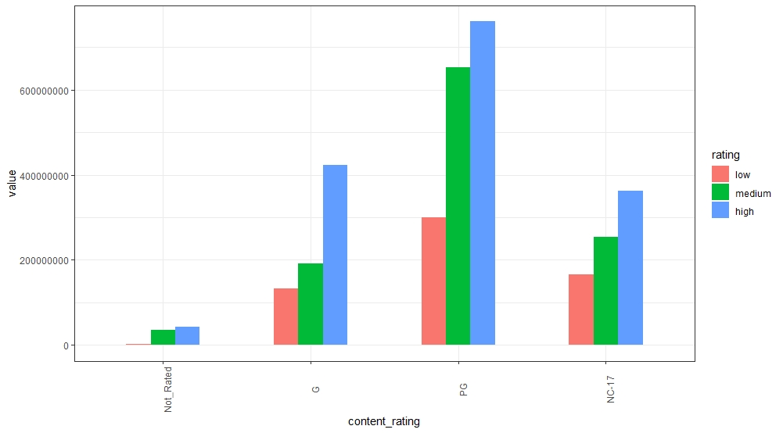
Response_variable
IMDB_SCORE
Classification of IMDB_score to three ratings: Low, Medium, High
Low: 0-5
Medium: 6-7
High: 8-10

Slide 9
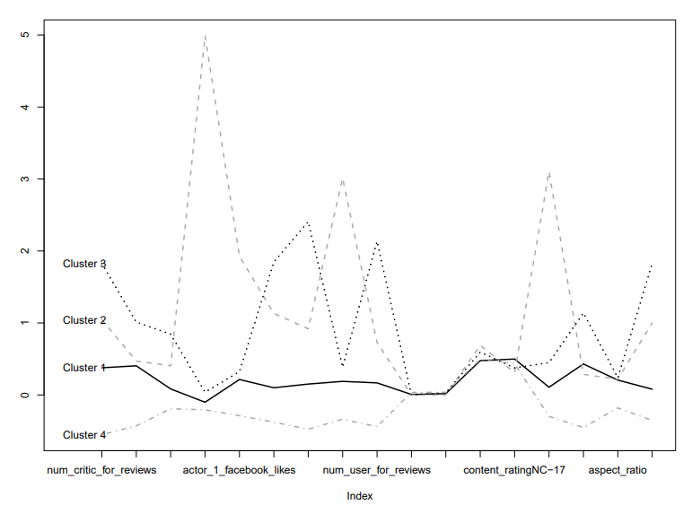
Clustering
Cluster 1: Lies between highest(C3) and lowest clusters (C4)
Cluster 2: High in actor 1,2 & 3 fb likes, cast total fb likes, and content rating PG
Cluster 3: High in number of voted users, number user for reviews, content rating PG, IMDB score and movie fb likes. It has the highest IMDB score and Gross
Cluster 4: Lowest in most variables, especially lowest in IMDB score and Gross.

Slide 10
Linear Regression
LR for predicting IMDB_Score
All variables are included: 16
Accuracy metrics for train and valid
Best Model using Exhaustive
Parsimonial model with variables
Accuracy
Best model comparison :

Slide 11
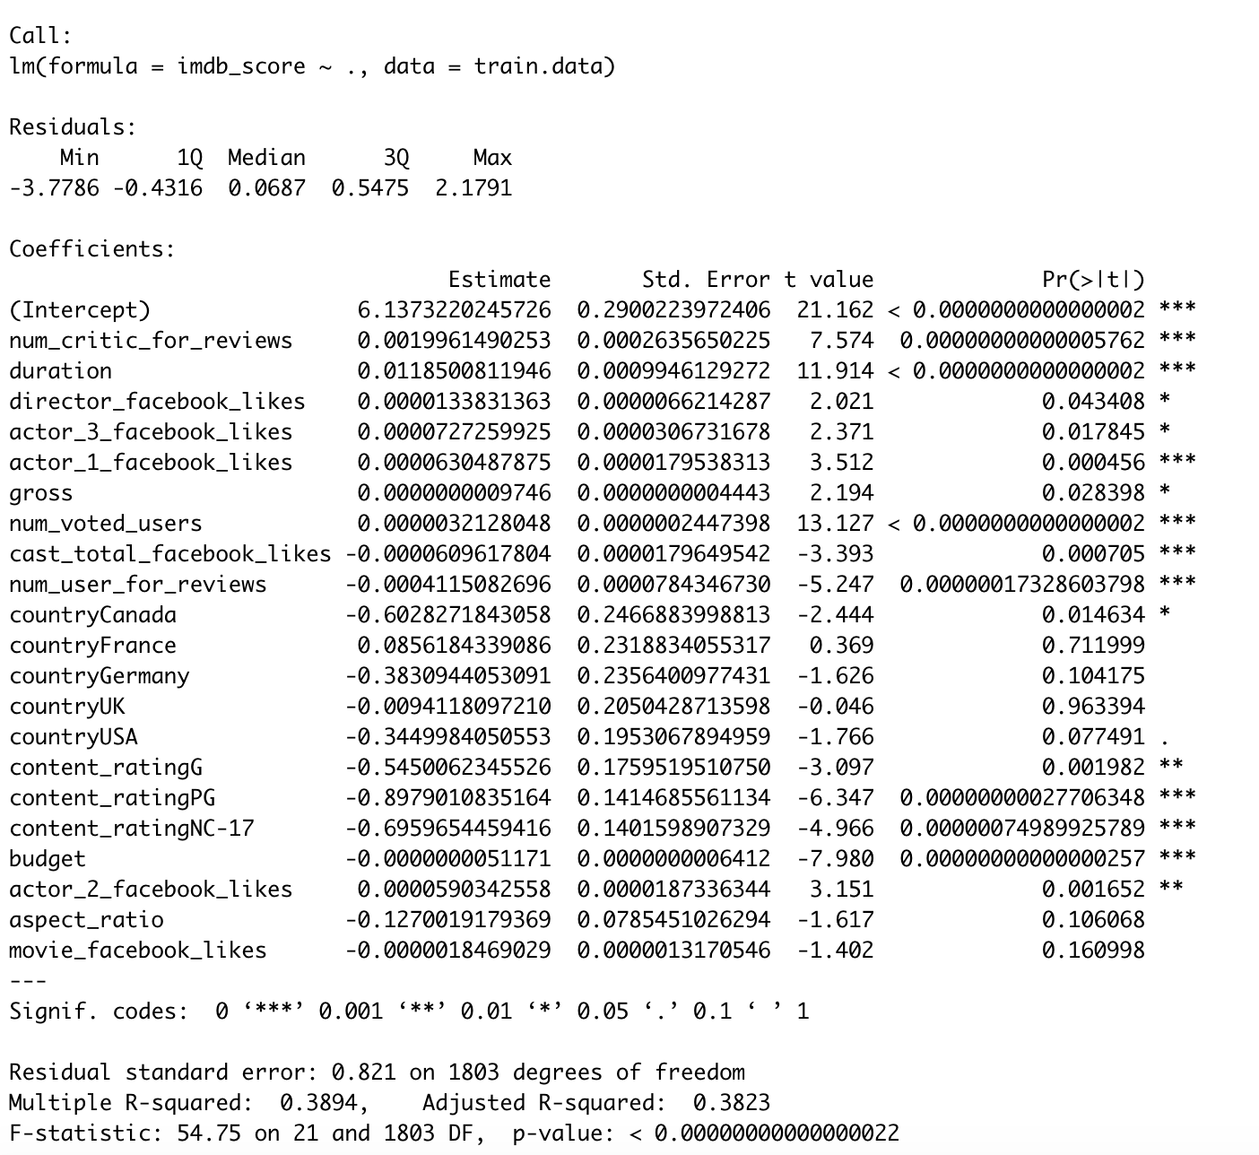
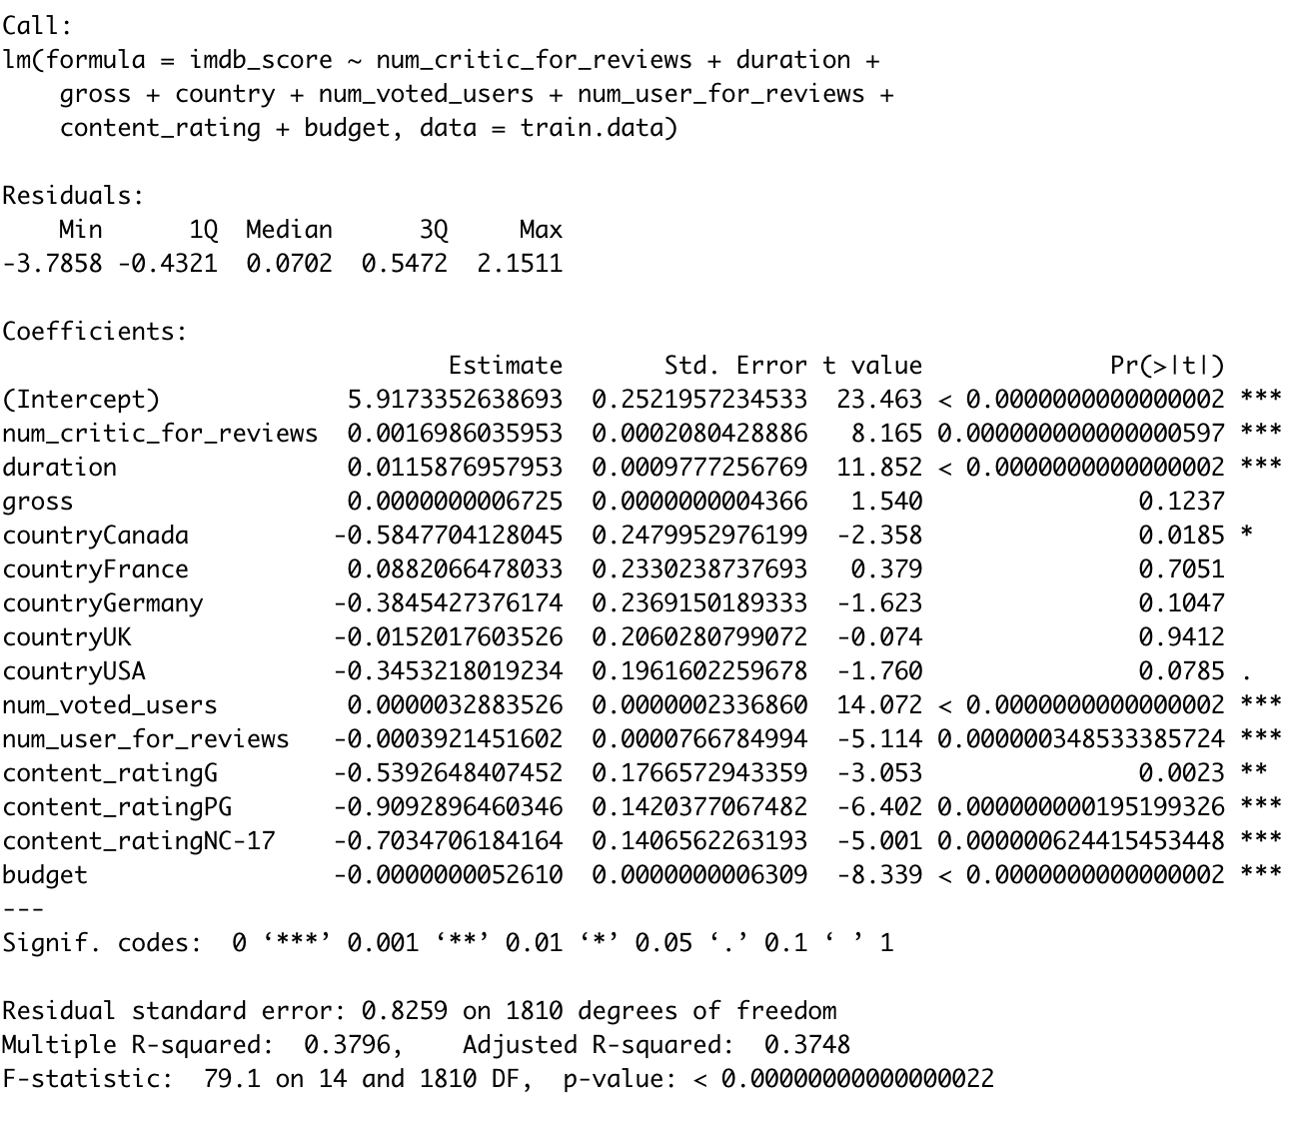
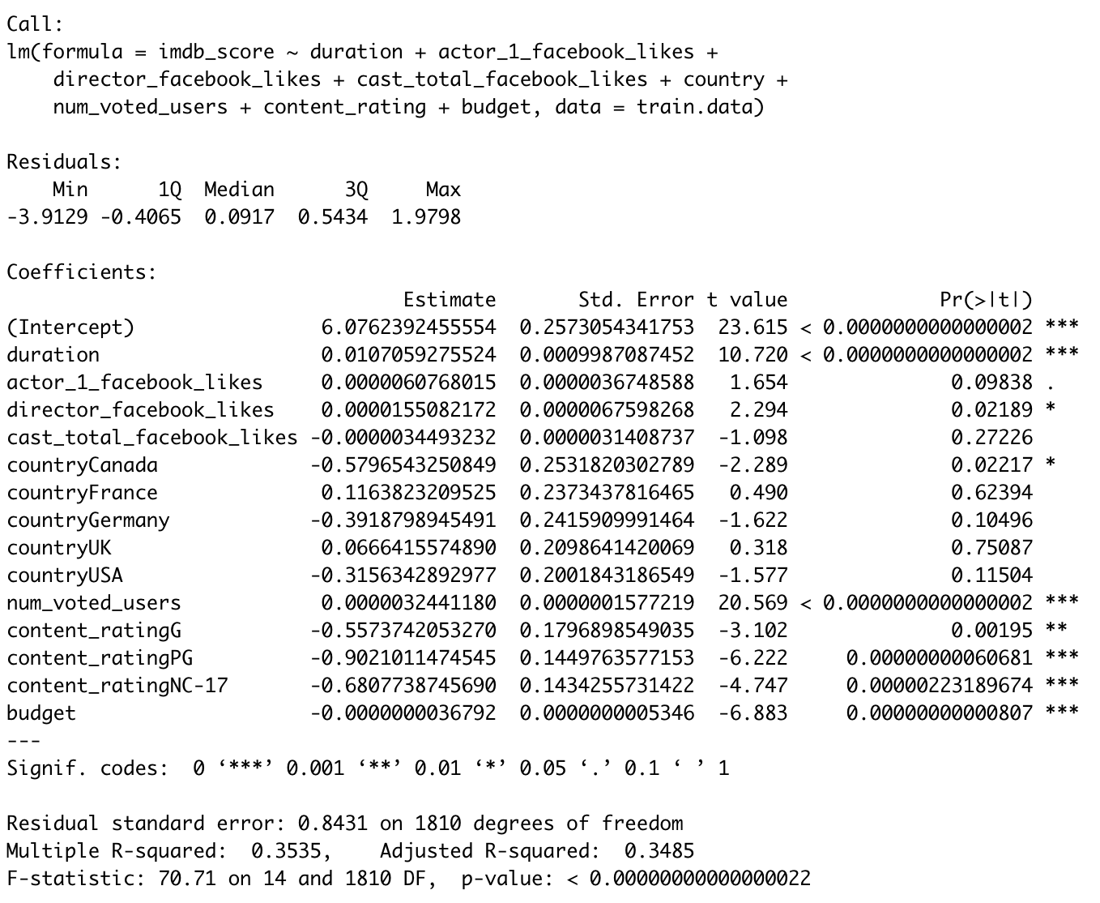
Multiple Variable Regression
MODEL | PREDICTORS | Adj R Square |  | ME | RMSE | MAE | MPE | MAPE
Default | All Predictors | 0.3823 | Train Data | -0.00000000000000005142763 | 0.815987 | 0.6159 | -2.35642 | 10.97095
 |  |  | Valid data | 0.026029 | 0.8229338 | 0.6255889 | -2.024453 | 11.10275
Best Model from Exhaustive search and Step | num_critic_for_reviews,duration,gross,country,num_voted_users,num_user_for_reviews,content_rating,budget | 0.3748 | Valid data | 0.02895664 | 0.8297594 | 0.6317254 | -2.023138 | 11.21116
Model to be used for new Movies | duration, actor_1_facebook_likes, director_facebook_likes , cast_total_facebook_likes , country, num_voted_users,content_rating,budget | 0.3485 | Valid data | 0.03500548 | 0.843845 | 0.6355749 | -2.031849 | 11.33211
Default
Best Model
New Movie

Slide 12
Neural Network

Slide 13
Logistic and neural net for classification

Slide 14
Anlaysis

Slide 15
Comparison between models

Slide 16
Results

